Slide 1

RideEzy – Where Search Becomes Easy
Presented By –
Rushikesh ​Goli
Saurabh Gaware
Akash Pandole
Ajay Shete

Slide 2
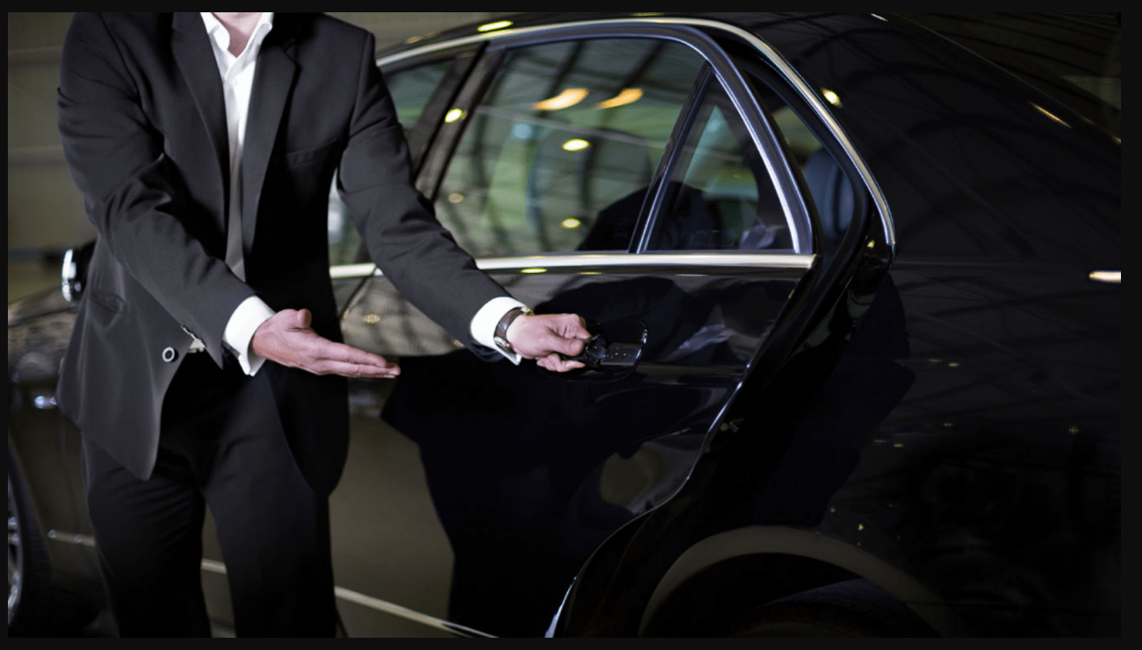
AGENDA
Introduction​
Objective
Project overview
​Areas of growth
Future Scope
​Summary​

Slide 3
Introduction
RideEzy is an online platform which deals with every aspect of people need's in travel industry where customer, vehicle owner & drivers can exchange their information in easy way. You can advertise, search & get vehicle to travel, enroll yourself as driver, search or book a driver and keep yourself updated with the latest vehicles and drivers data in the proposed city.

Slide 4
Choice of topics
Through this project the customer(users) will be provided with easy search of vehicles and drivers.
Easy and Fast.
Advertisement of Vehicles and Drivers.
Vehicles and Drivers Differentiation.

Slide 5
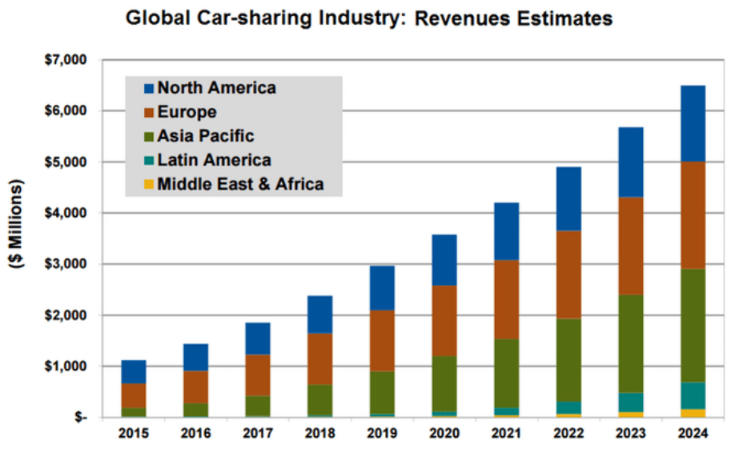
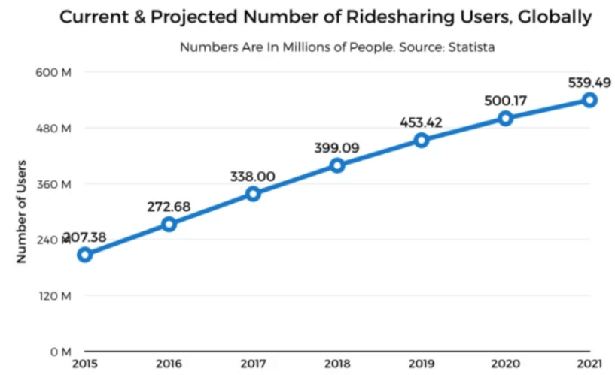
Growth throughout world

Slide 6

Purpose
The main objective of this project is to integrate drivers and vehicle owners such that drivers will get employment as their primary income even if they do not have their own vehicle but having proper driving skills
On the other side the person who has commercial vehicles like cars can get passive income while they are not using their vehicle.
The people who do not own any such commercial vehicle but if for a while they need one car, for them no need to request some people directly. They can get vehicles on rent along with the drivers if needed.

Slide 7
PROPOSED sYSTEM
AIM:
To bring driver ( who is looking for a driving job ), vehicle owner ( who is willing to generate passive income ) and customer/user ( who need vehicles for a while ) at one centralized platform.
To provide employment for skilled drivers.
To generate passive income for the people who have mobility assets.
To provide special service to the people(customers) i.e. easy mode of travel with rent (future scope).
To save hectic situation for vehicle owner in searching trusted driver.

Slide 8
Proposed system model
There are four main modules:
Admin Vehicle Owner Driver Customer
1.Login 1.Login 1.Login 1.Login
2.Home 2.Home 2.Home 2.home
3.Vehicles 3.Vehicle Category 3.Driver Category 3.All Category
4.Drivers 4.Add Vehicle 4.Add Driver 4.All Category
5.Logout 5.Logout 5.Logout 5.Logout

Slide 9
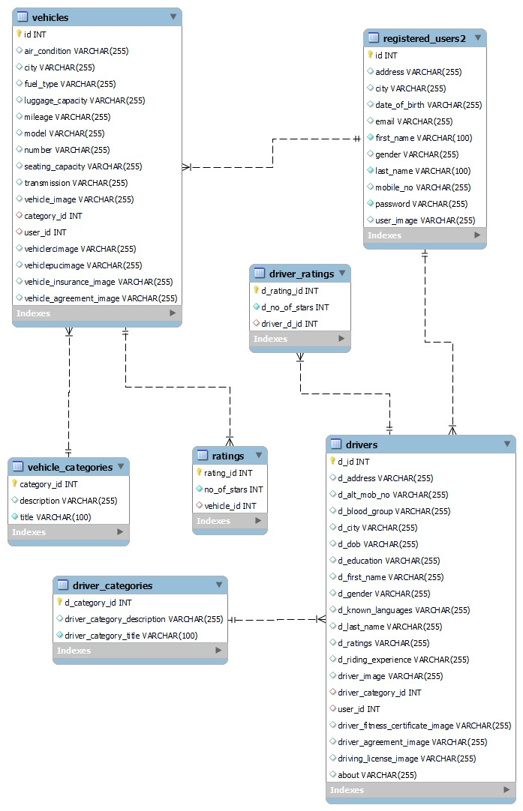
Proposed APPROACH

Slide 10
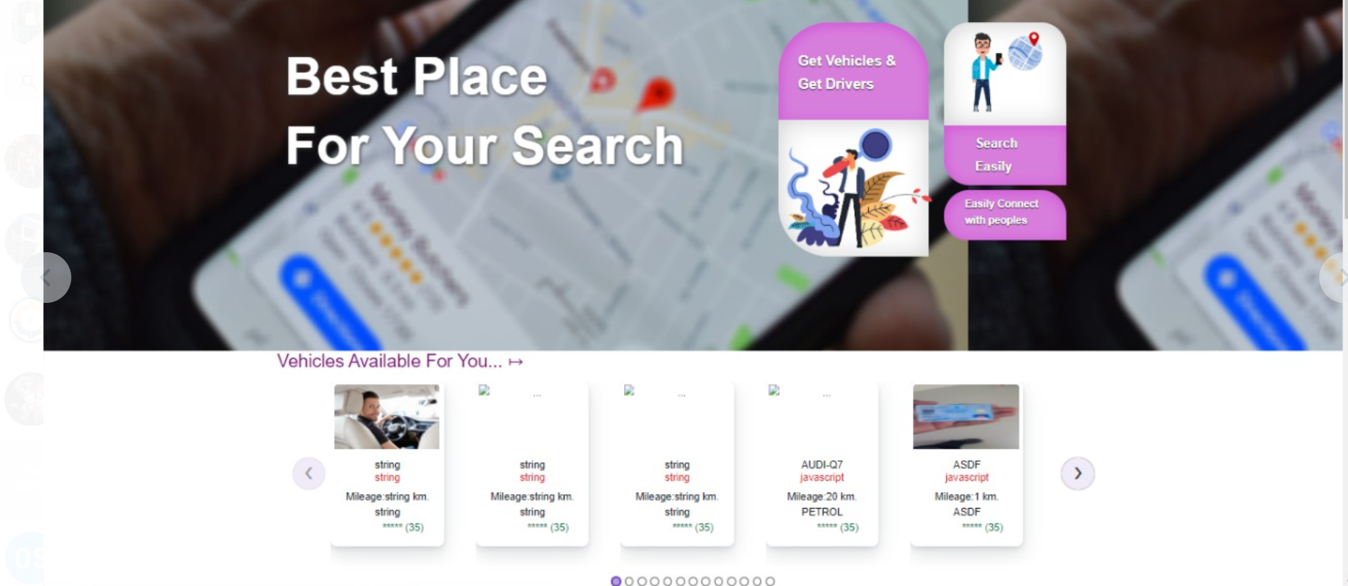
Website visit page

Slide 11
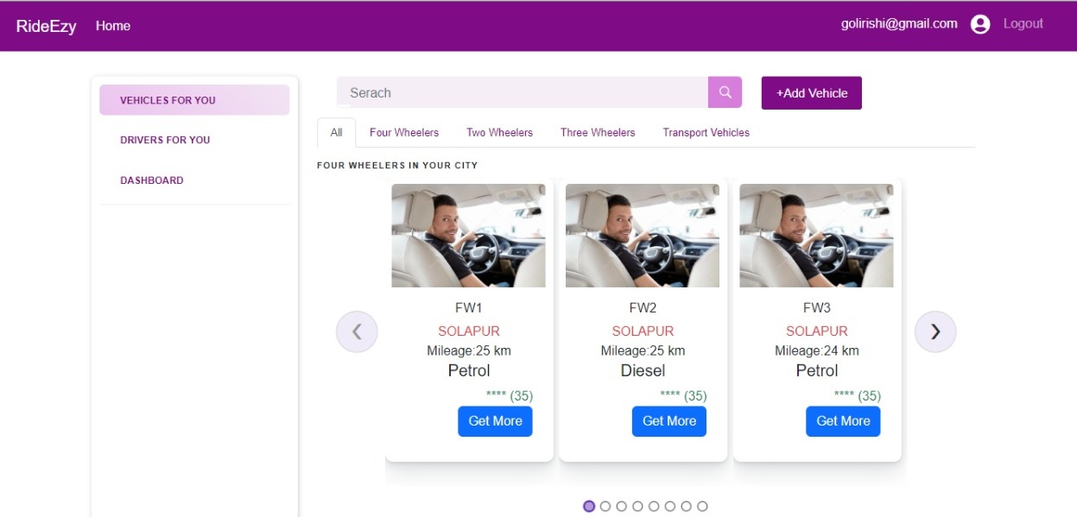
Homepage-post login

Slide 12
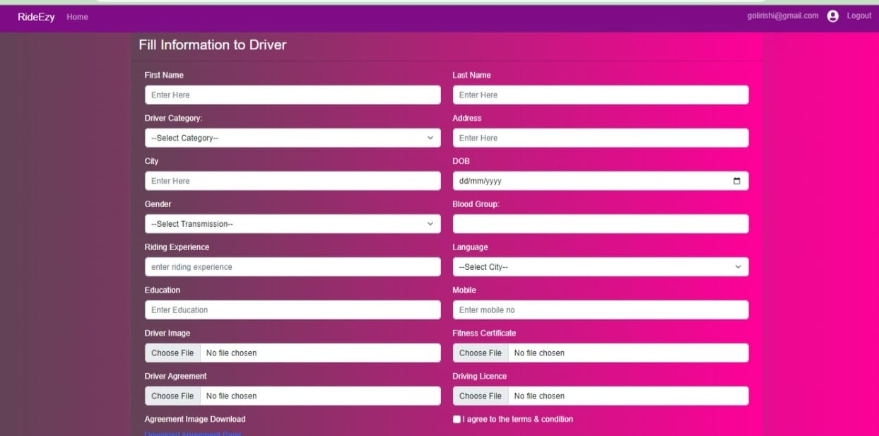
registration

Slide 13
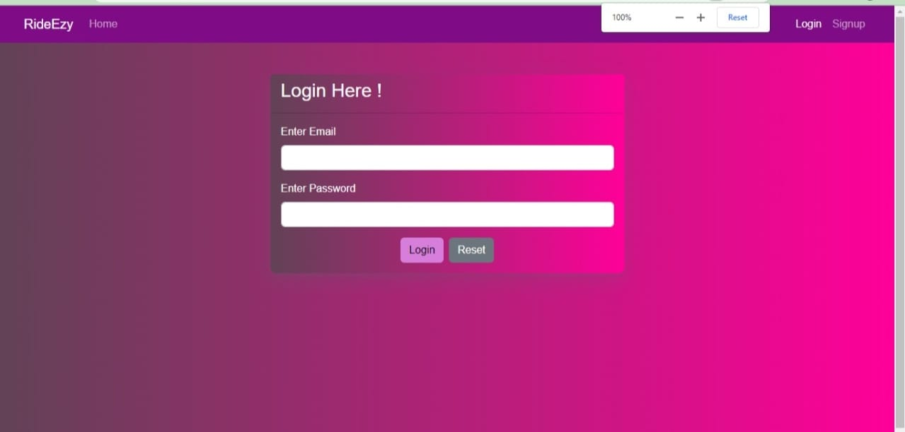
login

Slide 14
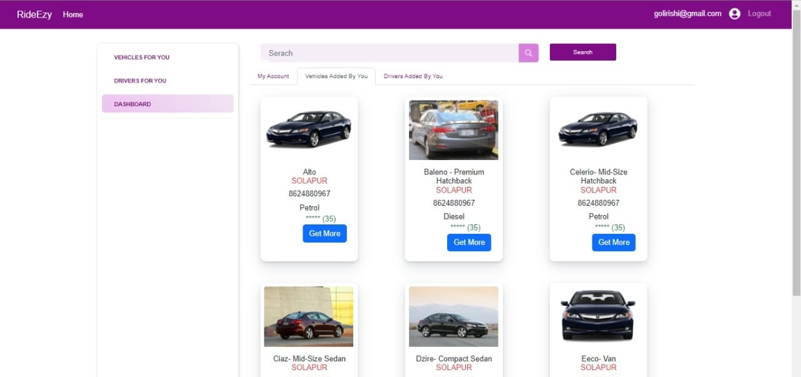
VEHICLES

Slide 15
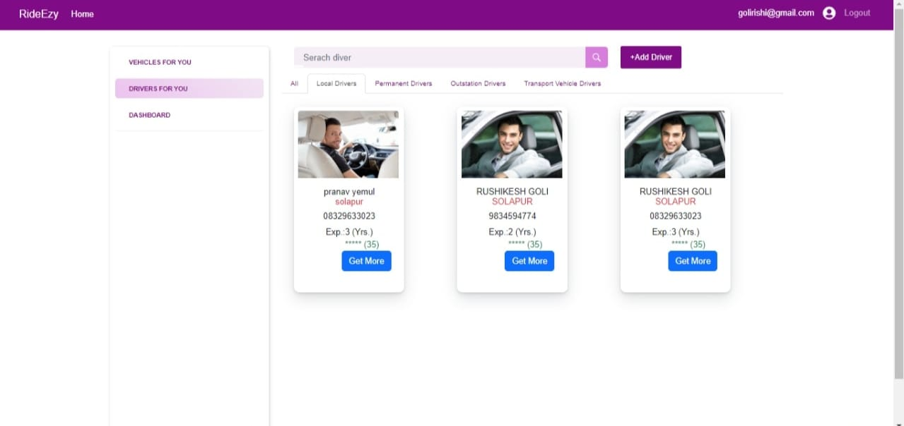
DRIVERS

Slide 16
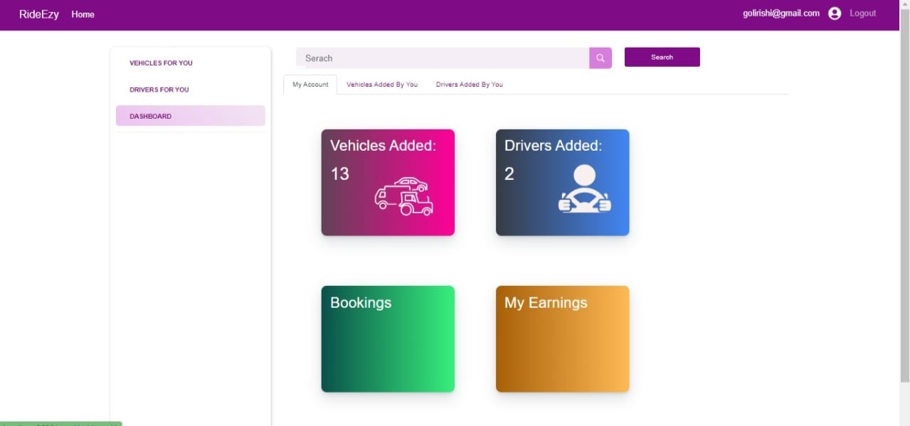
User dashboard

Slide 17
System Requirement
Software Requirements:
Windows (All versions)
Tomcat 9
Spring Tool Suite, MySQL
Hardware Components:
Processor – i3
HardDisk – 10 GB
Memory – 1 GB RAM

Slide 18
technologies Used
React & Bootstrap: All frontend is developed using React JS and Bootstrap with the following contents included.
HTML: Page Layout has been designed in HTML.
CSS: Used for all designing part.
JavaScript: All Validation task and animations has been developed by JS.
JAVA: All the business logic has been written in JAVA.
MySQL: database has been used as database.
Tomcat: Project will run using Tomcat Server.

Slide 19
Feasibility study
Before developing and implementing a system we have to make sure that the system is feasible in the following ways:
1. Technical Feasibility - In this type of feasibility study, the system analyst has to check whether it is possible or not to develop the requested system with availability of manpower, software, hardware, etc.
2. Operational Feasibility - In this type of feasibility study the operation implementation of the system is considered. Checking is done regarding whether it is feasible for the user department to use the framework.
3. Economical Feasibility -
In this type of feasibility study, the benefits of the system to the organization are considered by taking into consideration the cost-benefit analysis.

Slide 20
Project SPECIFICATION
Project Title – RideEzy – Integrated platform for vehicles and drivers Search
Front End Tools – React JS, Boost Strap
Back End Tool –Spring Boot
Database- MySQL
Operating System – Windows 10
Editor –Visual Studio 2019
Project management Tool – Jira

Slide 21





Data dictionary
Spring-boot
React js
My sql
aws
jira
Back-END Design
Front-END Design
Data Storage
Development and testing
Project Management

Slide 22
Advantages
To save hectic situation for vehicle owner in searching trusted driver.
Choice felxibility to customer over variety of vehicles as well as drivers in single platform.
3. People will reach their destination on time with comfort zone.
4.To generate passive income for the people who have mobility assets

Slide 23
Future scope
The pricing will be shown in future scope i.e. salary of the drivers, earnings of the vehicle owners, charges for the customers based on duration and distance and location.
The real time organization running on such ideology can make use of this web application.
It may help Collecting perfect management in details. It will help a person to know the management of passed year perfectly.
The bookings of vehicles and drivers can be taken in future module.

Slide 24
summary
In this era, people have less time and more work that force them to travel different places to work, business meeting and tourism. The public vehicle is not the best option. Public vehicles are crowded, generally not running on time e.g. trains, buses etc. The main problem that people face nowadays is to reach their destination on time with comfort.
RideEzy comes up with a solution to all these problems. People can choose a vehicle for trip, marriage, business meeting, office to home, home to office, and home to a market whenever they want.
Consumers these days are looking for ways to travel in affordable ways and it seems like the future of ride-hailing services is bright. However, there are many factors that an organization has to consider, for instance security of the users, market challenges, localization, and user-driver supply-demand.

Slide 25
refrences
Mr. Saleel Bagde for Database.
Ms. Harshita Maheshwari for HTML JS & CSS also she is our project guide.
Youtube: Learn Code With Durgesh Channel
A special thanks to Infoway Management who arranged extra lab time for us.

Slide 26

THANK YOU…!
“
OPPORTUNITIES ARE LIKE Taxi, THERE'S ALWAYS ANOTHER ONE COMING.
”
- Richard Branson

